Slide 1


Data-Driven Insights for Various Factors affecting Diabetes
CS608 – Advance Techniques in Data Science
Presented To: Prof. Dr. M. Awais Hassan
Presented By: Rizwan Riaz Mir (2023-PhD-CS-08)

Slide 2
Q1: Is there a significant relationship between BMI, cholesterol, blood pressure and the likelihood of diabetes? Q2: Is there a pattern between age, gender, education, income levels, and the prevalence of diabetes? Q3: Does the intake of fruits and vegetables along with being physically active reduce the risk of diabetes? Q4: Is there any significant correlation between diabetes, cardiovascular disease, alcohol and smoking? Q5: How do mental and physical health directly correlate with worsening of diabetes?
Important Questions to be answered:

Slide 3
Exploratory Data analysis (EDA)

Slide 4
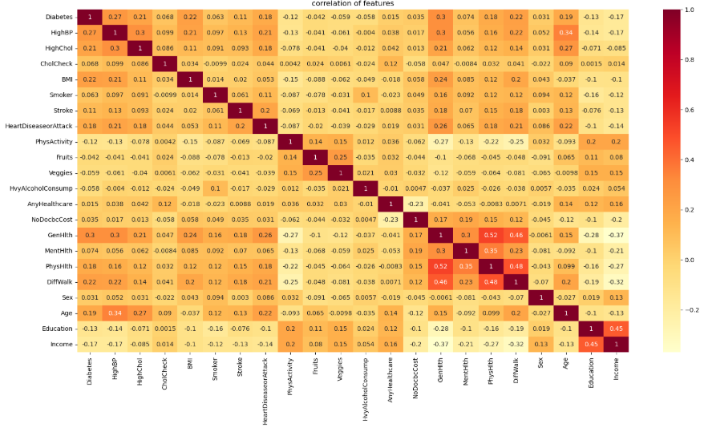
Correlations between features:
Logical
- GenHlth
- PhysHlth
- DiffWalk
Ir-relevant
- Income
- GenHlth
- DiffWalk

Slide 5
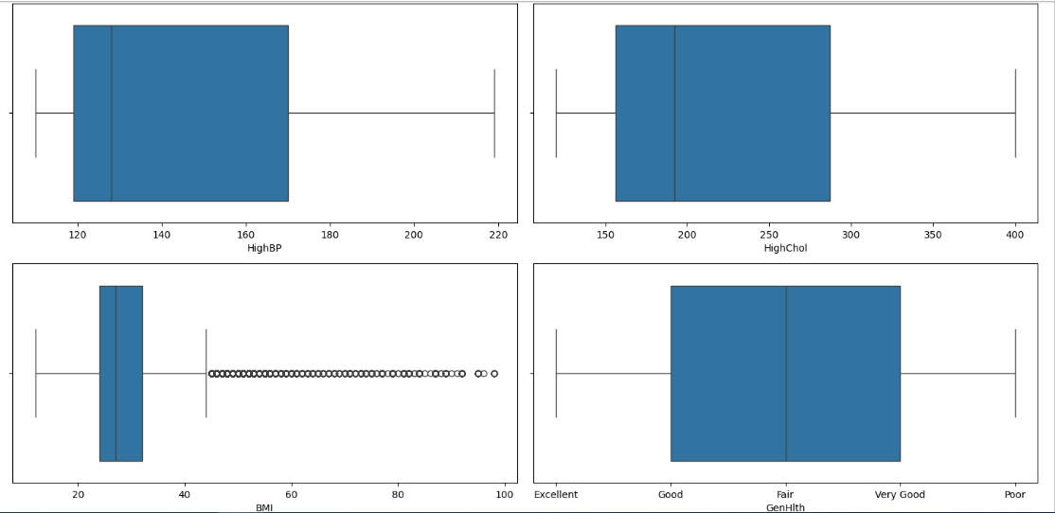
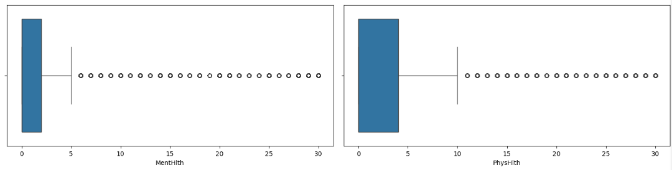
Detecting Outliers:

Slide 6
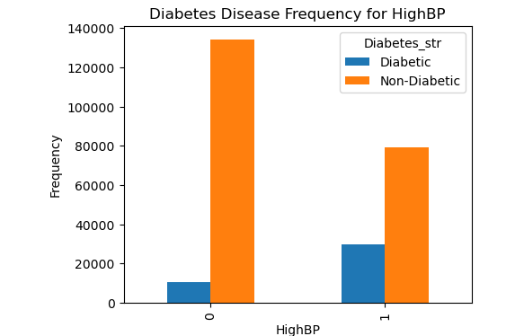
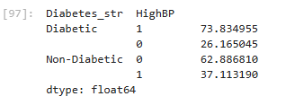
Correlation b/w Diabetes and Blood Pressure:

Slide 7
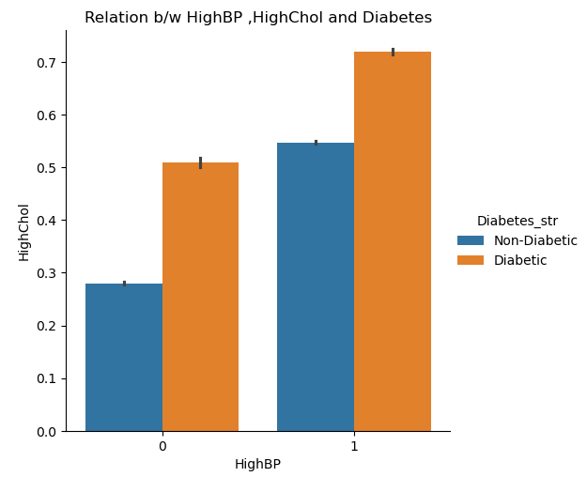
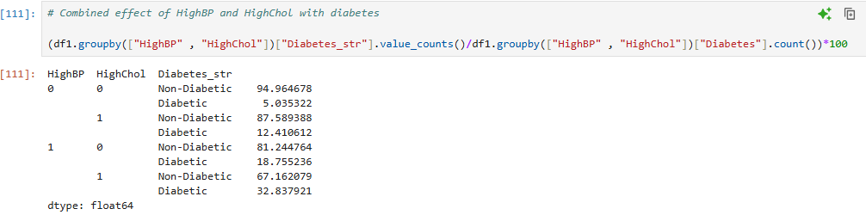
Correlation among Diabetes, Blood Pressure and Cholesterol:

Slide 8
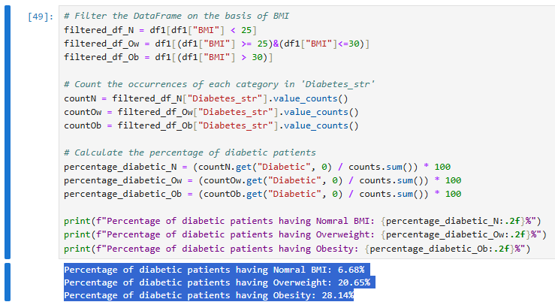
Correlation b/w Diabetes and BMI:

Slide 9
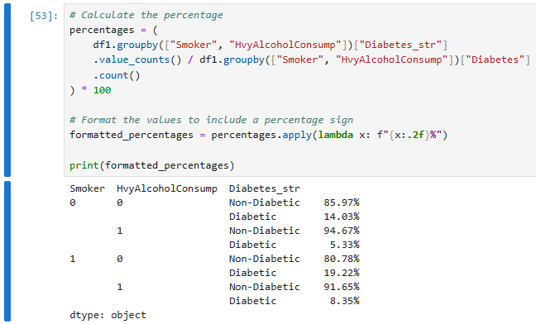
Correlation among Diabetes, Smoking and Alcohol:

Slide 10
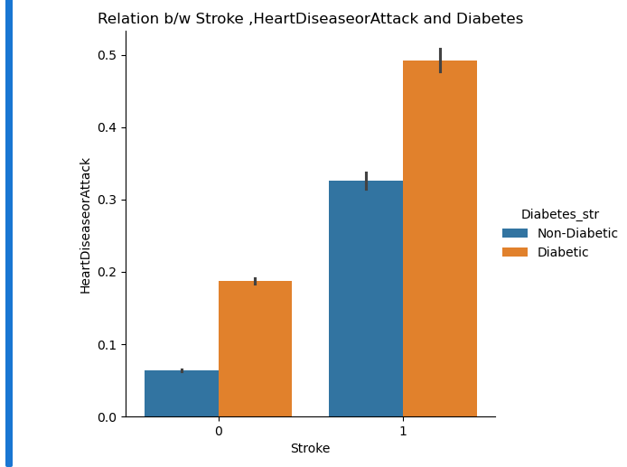
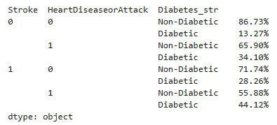
Correlation among Diabetes, Stroke and Heart Disease:

Slide 11
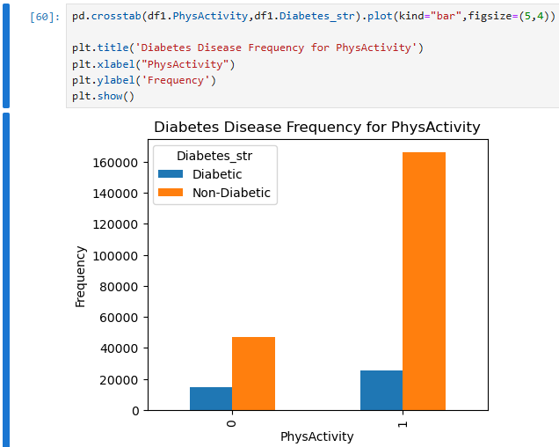
Correlation b/w Diabetes and Physical Activity:

Slide 12
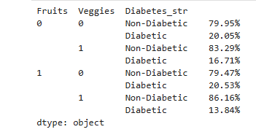
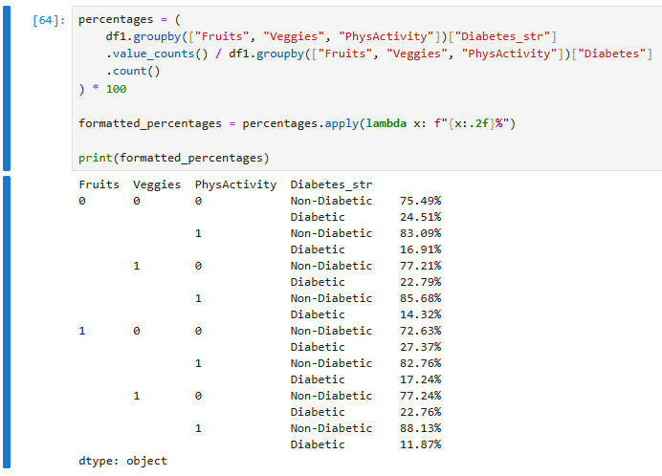
Correlation among Diabetes, Fruits, vegetables intake and Physical Activity:

Slide 13
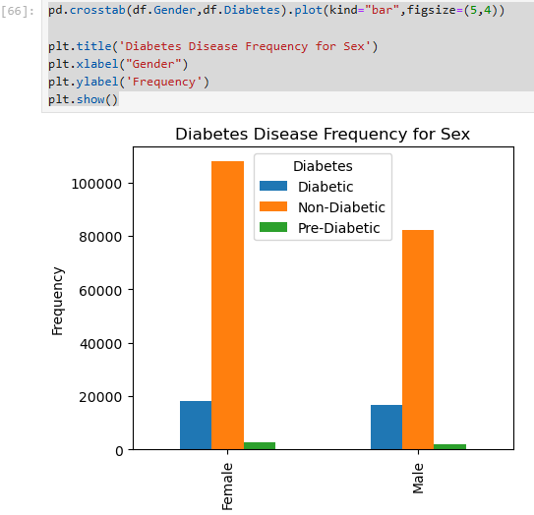
Correlation b/w Diabetes and Gender:

Slide 14
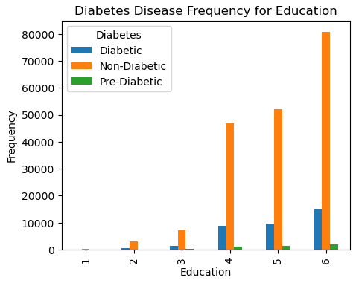
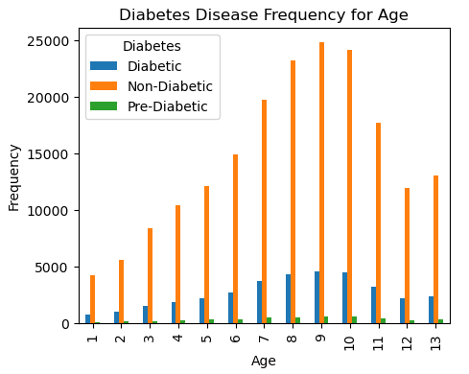
Correlation b/w Diabetes, Income and Education:

Slide 15
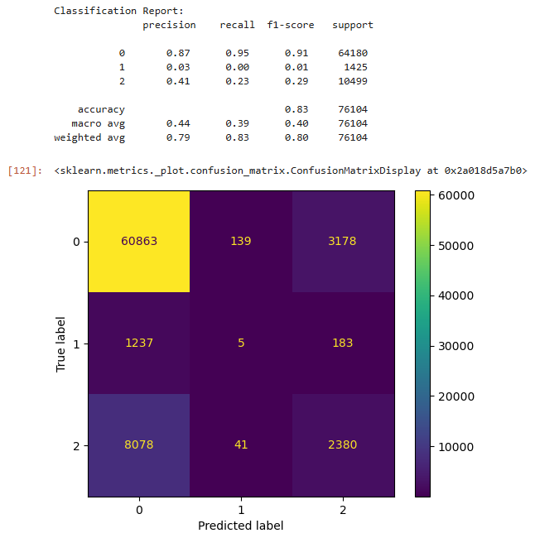
Predictive Analysis using Random Forest Classifier: (Results)

Slide 16
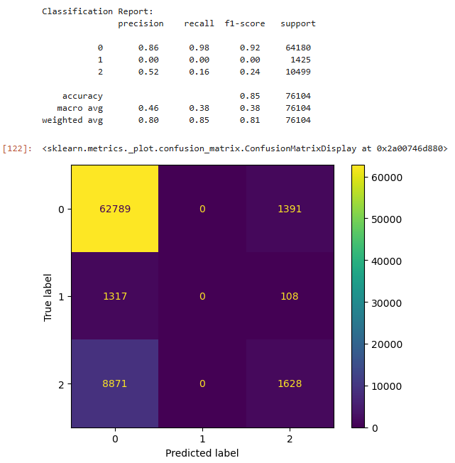
Predictive Analysis using Logistic Regression Classifier: (Results)

Slide 17
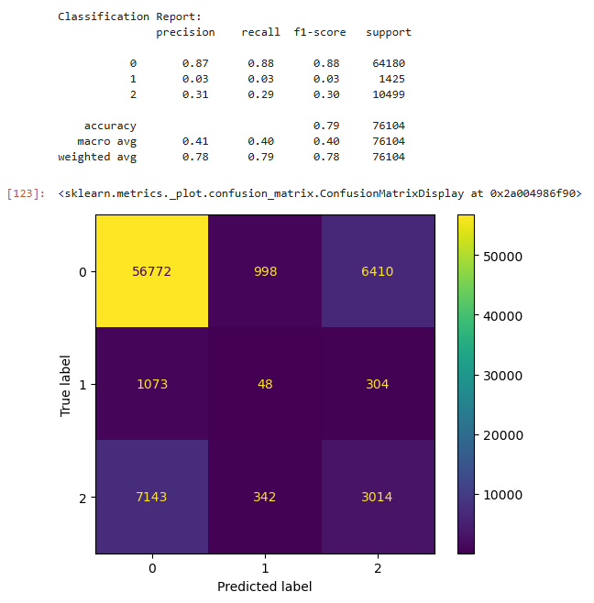
Predictive Analysis using Decision Tree Classifier: (Results)

Slide 18
Comparing and Discussing Results of Predictive Analysis:
1 - Class 0 (No Diabetes) Performance: All three classifiers (Random Forest, Logistic Regression, and Decision Tree) predict Class 0 (no diabetes) well.
2 - Poor Performance for Class 1 (Diabetes): All classifiers (Random Forest, Logistic Regression, and Decision Tree) fail to identify Class 1 (diabetes) effectively, with near-zero precision and recall for this class.
3 - Class 2 (Pre-Diabetes) Performance: The classifiers perform better for Class 2 (pre-diabetes) compared to Class 1, but still show insufficient performance, particularly in recall.
4 - Class Imbalance Issue: The performance is biased due to the class disparity, with the majority class (Class 0) dominating the metrics, resulting in poor prediction accuracy for the minority classes.
5 - Potential Improvements: To enhance performance, methods such as resampling, adjusting class weights, or using more advanced models like ensemble methods or neural networks could be employed, especially for improving predictions for Class 1 and Class 2.

Slide 19
Thanks!
to have a BIG Heart to
shape our Little Minds

